Slide 1




Slide 2
Fine-tuning a Question-Answering system
Notes:
Hello and welcome, in this video we will start to dive into the components of the internal structure of transformers.

Slide 3
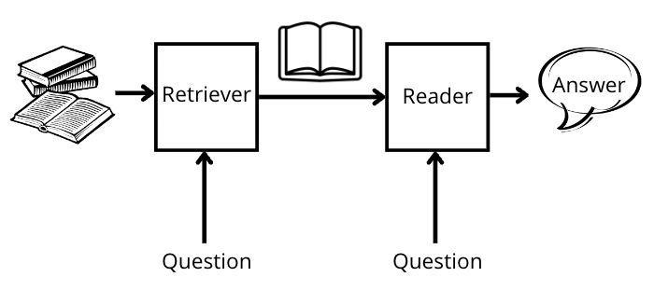
Introduction
QA system comprises two main components: the retriever and the reader.
The retriever's role: is to search through a vast amount of documents or knowledge sources to identify relevant passages for a given question.
The reader: which is typically a deep learning model, extracts the answer from the retrieved passages.

Slide 4
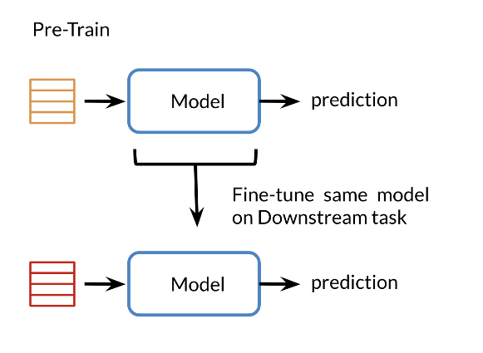
Introduction
Fine-tuning is a process of adapting a pre-trained model to a specific domain or task by further training it on domain specific data.
Fine-tuning offers several benefits for domain adaptation in QA systems.
It helps the models understand the context and nuances of a particular domain, leading to more accurate answers.
Fine-tuning allows the system to leverage domain-specific knowledge and improves its performance when dealing with domain-specific queries.

Slide 5
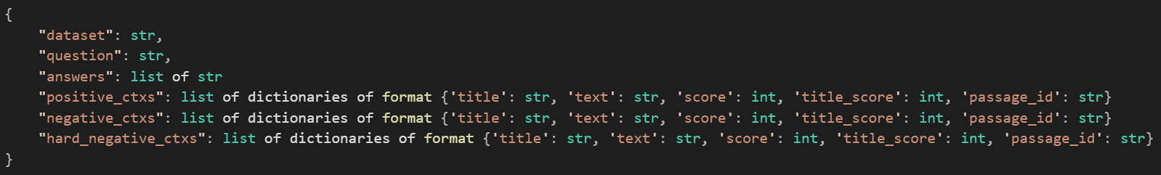
How to fine-tune the retriever model ?
The retriever is responsible for efficiently searching and retrieving relevant passages.
Fine-tune the retriever using haystack framework:
Haystack contains all the tools needed to train your own Dense Passage Retrieval model.
Prepare the dataset:
Want to feed in pairs of queries and relevant documents.
Train a model:
The dataset that has the same format as the original DPR training data.
Positive_ctxs are context passages which are relevant to the query.

Slide 6
How to fine-tune the retriever model ?
The retriever is responsible for efficiently searching and retrieving relevant passages.
Fine-tune the retriever using haystack framework:
Haystack contains all the tools needed to train your own Dense Passage Retrieval model.
Prepare the dataset:
Want to feed in pairs of queries and relevant documents.
Train a model:
The dataset that has the same format as the original DPR training data.
Positive_ctxs are context passages which are relevant to the query.
negative_ctxs is not actually used in Haystack's DPR training so we recommend you set it to an empty list. They were used by the original DPR authors in an experiment to compare it against the in-batch negatives method.

Slide 7
How to fine-tune the retriever model ?
The retriever is responsible for efficiently searching and retrieving relevant passages.
Fine-tune the retriever using haystack framework:
Haystack contains all the tools needed to train your own Dense Passage Retrieval model.
Prepare the dataset:
Want to feed in pairs of queries and relevant documents.
Train a model:
The dataset that has the same format as the original DPR training data.
Positive_ctxs are context passages which are relevant to the query.
negative_ctxs is not actually used in Haystack's DPR training so we recommend you set it to an empty list. They were used by the original DPR authors in an experiment to compare it against the in-batch negatives method.
hard_negative_ctxs are passages that are not relevant to the query. In the original DPR paper, these are fetched using a retriever to find the most relevant passages to the query. Passages which contain the answer text are filtered out.

Slide 8
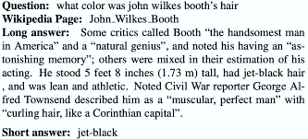
Google's Natural Questions dataset
Is sufficiently large and contains enough unique passages, that it can be converted into a DPR training set.
This is done simply by considering answer containing passages as relevant documents to the query.
The SQuAD dataset, however, is not as suited to this use case since its question-and-answer pairs are created on only a very small slice of wikipedia documents

Slide 9
1. Prepare the dataset
Download the original DPR training data:
Note: that Google's Natural Questions dataset data is probably only useful if you are trying to train from scratch.
2. Initialize both passage and query embedding models using BERT base.
The model is trained using Google's Natural Questions dataset in a format specialized for DPR.
# Download original DPR data
# WARNING: the train set is 7.4GB and the dev set is 800MB doc_dir = "data/tutorial9“
s3_url_train = "https://dl.fbaipublicfiles.com/dpr/data/retriever/biencoder-nq-train.json.gz"
s3_url_dev = "https://dl.fbaipublicfiles.com/dpr/data/retriever/biencoder-nq-dev.json.gz"
fetch_archive_from_http(s3_url_train, output_dir=doc_dir + "/train")
fetch_archive_from_http(s3_url_dev, output_dir=doc_dir + "/dev")
# Here are the variables to specify our training data, the models that we use to initialize DPR
# and the directory where we'll be saving the model
train_filename = "train/biencoder-nq-train.json"
dev_filename = "dev/biencoder-nq-dev.json"
query_model = "bert-base-uncased"
passage_model = "bert-base-uncased"
save_dir = "../saved_models/dpr"

Slide 10
1. Prepare the dataset
3. Initialize both query and passage models using the original pretrained model from Facebook.
# Here are the variables you might want to use instead of the set above
# in order to perform pretraining
doc_dir = "PATH_TO_YOUR_DATA_DIR"
train_filename = "TRAIN_FILENAME"
dev_filename = "DEV_FILENAME"
query_model = "facebook/dpr-question_encoder-single-nq-base"
passage_model = "facebook/dpr-ctx_encoder-single-nq-base"
save_dir = "../saved_models/dpr"

Slide 11
1. Prepare the dataset
3. Initialize both query and passage models using the original pretrained model from Facebook.
# Here are the variables you might want to use instead of the set above
# in order to perform pretraining
doc_dir = "PATH_TO_YOUR_DATA_DIR"
train_filename = "TRAIN_FILENAME"
dev_filename = "DEV_FILENAME"
query_model = "facebook/dpr-question_encoder-single-nq-base"
passage_model = "facebook/dpr-ctx_encoder-single-nq-base"
save_dir = "../saved_models/dpr"
from haystack.nodes import DensePassageRetriever
from haystack.document_stores import InMemoryDocumentStore
retriever = DensePassageRetriever(
document_store=InMemoryDocumentStore(),
query_embedding_model=query_model,
passage_embedding_model=passage_model,
max_seq_len_query=64,
max_seq_len_passage=256,
)

Slide 12
2. Train Model
embed_title=True: the document title is prepended to the input text sequence with a [SEP] token between it and document text
# Start training our model and save it when it is finished
retriever.train(
data_dir=doc_dir,
train_filename=train_filename,
dev_filename=dev_filename,
test_filename=dev_filename,
n_epochs=1,
batch_size=16,
grad_acc_steps=8,
save_dir=save_dir,
evaluate_every=3000,
embed_title=True,
num_positives=1,
num_hard_negatives=1,
)
reloaded_retriever = DensePassageRetriever.load(load_dir=save_dir, document_store=None)

Slide 13
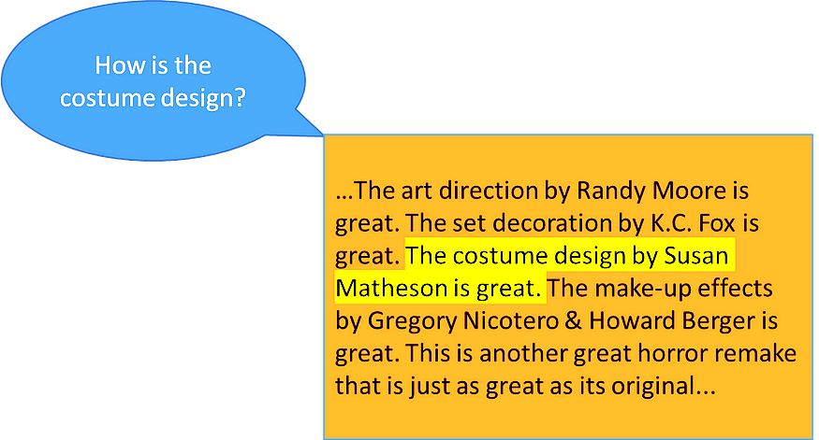
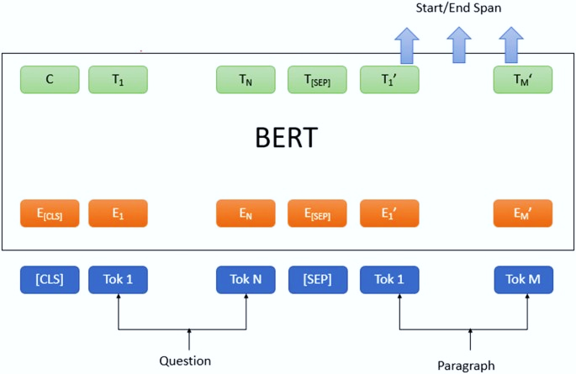
How to fine-tune the reader model ?
The reader's role is to understand the retrieved passages and extract the most accurate answer to the given question.
Question answering task: is the task of extracting the answer to a question from a given context

Slide 14
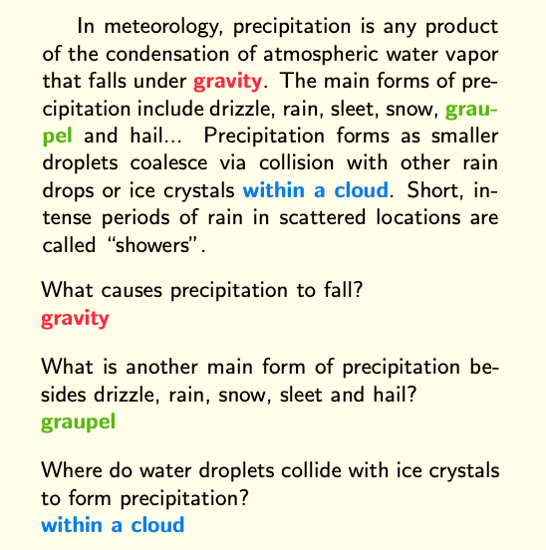
How to fine-tune the reader model ?
For our example:
we'll use the SQUAD dataset, The same codes should work with any question answering dataset provided by the hugging face Datasets library
Note: If you're using your own dataset defined from a JSON or csv it might need some adjustments in the names of the columns used
remember that any question answer dataset should have the three main features or columns which are the question , the context , and the answer.

Slide 15
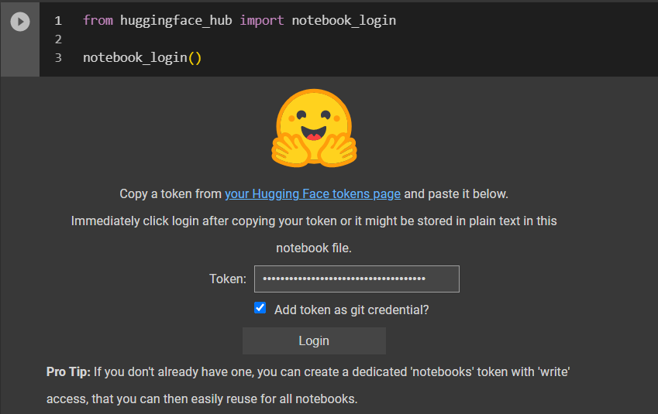
How to fine-tune the reader model ?
install the transformers and datasets libraries
To login to your hugging face account with your read access token.
! pip install datasets transformers

Slide 16
How to fine-tune the reader model ?
install the transformers and datasets libraries
To login to your hugging face account with your read access token.
Use bert base uncased pretrained model as our checkpoint
! pip install datasets transformers
model_checkpoint = "distilbert-base-uncased"
batch_size = 16

Slide 17
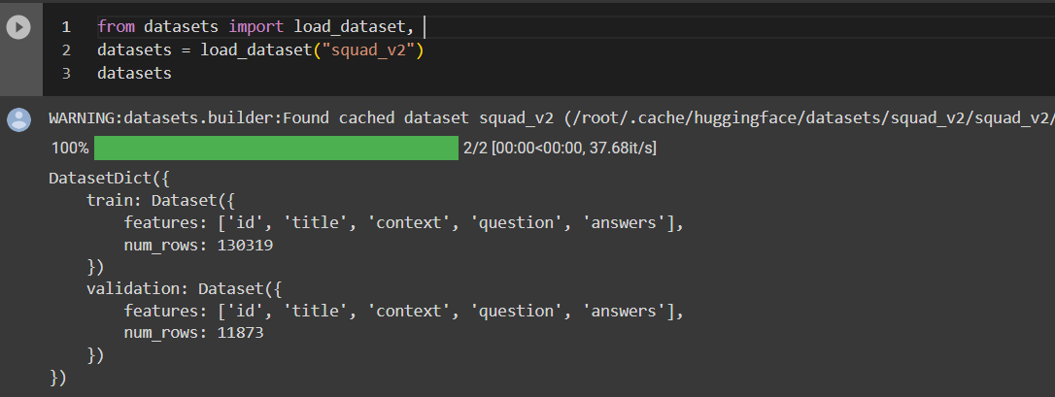
How to fine-tune the reader model ?
4. Use the hugging face Datasets library to download the data
The datasets object itself is Dataset Dictionary, which contains one key for the training, validation and test set.
The training, validation and test sets all have a column for the context, the question and the answers to those questions
To access an actual element:
datasets["train"][0]
{'answers': {'answer_start': [515], 'text': ['Saint Bernadette Soubirous']}, 'context': 'Architecturally, the school has a Catholic character. Atop the Main Building\'s gold dome is a golden statue of the Virgin Mary. Immediately in front of the Main Building and facing it, is a copper statue of Christ with arms upraised with the legend "Venite Ad Me Omnes". Next to the Main Building is the Basilica of the Sacred Heart. Immediately behind the basilica is the Grotto, a Marian place of prayer and reflection. It is a replica of the grotto at Lourdes, France where the Virgin Mary reputedly appeared to Saint Bernadette Soubirous in 1858. At the end of the main drive (and in a direct line that connects through 3 statues and the Gold Dome), is a simple, modern stone statue of Mary.', 'id': '5733be284776f41900661182', 'question': 'To whom did the Virgin Mary allegedly appear in 1858 in Lourdes France?', 'title': 'University_of_Notre_Dame'}

Slide 18
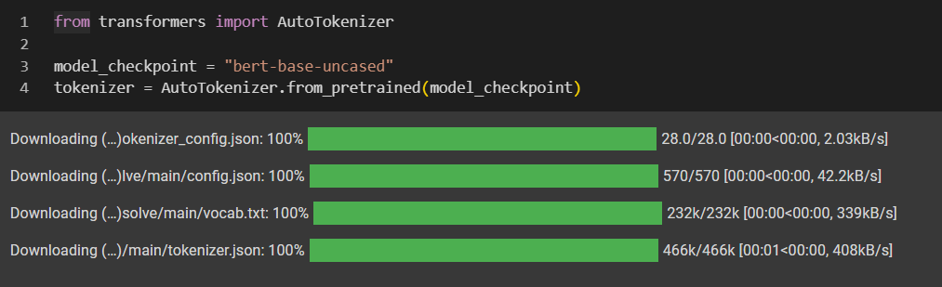
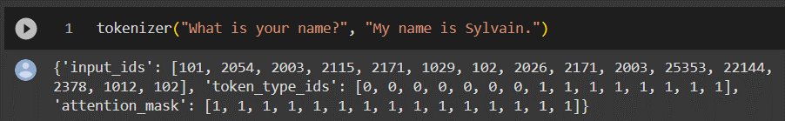
Preprocessing the training data
Transformers Tokenizer: which will tokenize the inputs including converting the tokens to their corresponding IDs in the pretrained vocabulary and put it in a format the model expects, as well as generate the other inputs that model requires.
Instantiate our tokenizer:
Download the vocabulary used when pretraining this specific checkpoint.
That vocabulary will be cached
Call this tokenizer on two sentences one for the answer, one for the context.
Note: that token type id distinguish between question and context.

Slide 19
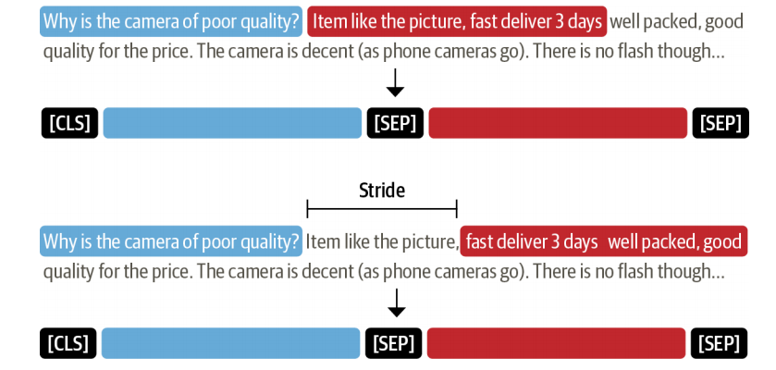
How to deal with very long documents?
Usually truncate them in other tasks, when they are longer than the model maximum sentence length.
Removing part of the context might result in losing the answer we are looking for.
The standard way to deal with this is to apply a sliding window across the inputs, where each window contains a passage of tokens that fit in the model’s context.

Slide 20
Preprocessing the training data: Tokenization
To enable the sliding window set return_overflowing_tokens=True in the tokenizer.
The size of the sliding window is controlled by the max_length argument,
The size of the stride is controlled by doc_stride.
Note: that we never want to truncate the question, only the context
The only_second truncation picked: the tokenizer can automatically return us a list of features capped by a certain maximum length, with the overlap.
To find in which of those features the answer actually is:
The models we will use require the start and end positions of these answers in the tokens, so we will also need to map parts of the original context to some tokens.
The tokenizer are using can help us with that by returning an offset_mapping.
tokenized_example = tokenizer(
example["question"],
example["context"],
max_length=max_length,
truncation="only_second",
return_overflowing_tokens=True,
stride=doc_stride
)

Slide 21
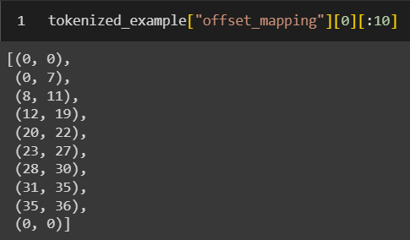
Preprocessing the training data: Tokenization
for each index of our input IDS, the corresponding start and end character in the original text that gave our token.
The very first token ([CLS]) has (0, 0) because it doesn't correspond to any part of the question/ answer.

Slide 22

Preprocessing the training data: Tokenization
for each index of our input IDS, the corresponding start and end character in the original text that gave our token.
The very first token ([CLS]) has (0, 0) because it doesn't correspond to any part of the question/ answer.
The second token is the same as the characters 0 to 7 of the question.
To account for the special case where the model expects padding on the left (in which case we switch the order of the question and the context)

Slide 23
Preprocessing the training data: Tokenization
Apply this function on all the sentences (or pairs of sentences) in our dataset:
Apply the function on all the elements of all the splits in dataset, so our training, validation and testing data will be preprocessed in one single command.
Since our preprocessing changes the number of samples, needing to remove the old columns when applying it.
Note that we passed batched=True to encode the texts by batches together.
This is to leverage the full benefit of the fast tokenizer we loaded earlier, which will use multi-threading to treat the texts in a batch concurrently.

Slide 24
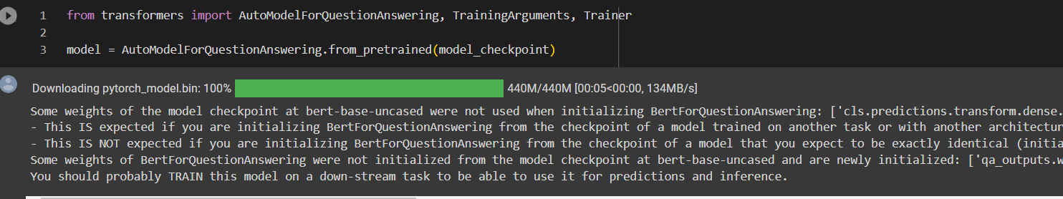
Train Reader
1. Download the pretrained model and fine-tune it:
The warning is telling us we are throwing away some weights (the vocabulary transform and vocabulary layer norm layers) and randomly initializing some other (the pre classifier and classifier layers).
This is absolutely normal in this case, because we are removing the head used to pretrain the model on a masked language modeling objective and replacing it with a new head for which we don't have pretrained weights, so the library warns us we should fine-tune this model before using it for inference, which is exactly what we are going to do.

Slide 25
Train Reader
model_name = model_checkpoint.split("/")[-1]
args = TrainingArguments(
f"{model_name}-finetuned-squad",
evaluation_strategy = "epoch",
learning_rate=2e-5,
per_device_train_batch_size=batch_size,
per_device_eval_batch_size=batch_size,
num_train_epochs=3,
weight_decay=0.01,
push_to_hub=True,
)
If you want to save your model locally in a name that is different than the name of the repository it will be pushed, or if you want to push your model under an organization and not your name space, use the hub_model_id argument to set the repo name .
2. Data collator that will batch our processed examples together:
from transformers import default_data_collator
data_collator = default_data_collator

Slide 26
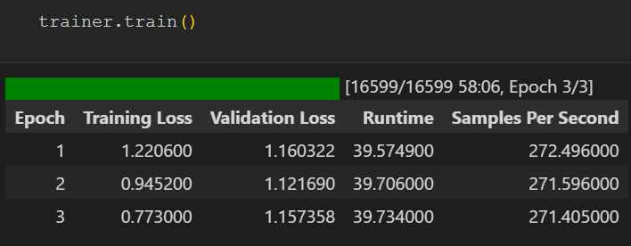

Train Reader
3. Pass all of this along with our datasets to the Trainer
4. finetune our model by just calling the train method.
4. After finishing the training, you can save your own model locally.
trainer = Trainer(
model,
args,
train_dataset=tokenized_datasets["train"],
eval_dataset=tokenized_datasets["validation"],
data_collator=data_collator,
tokenizer=tokenizer,
)

Slide 27
Homework
fine-tuning and left evaluation of your new fine-tuned model
you will find the code of evaluation in the Reader QA notebook you should go through it step by step.

Slide 28
References
The haystack Dense Retriever Passages training notebook and hugging face question answering on Squad Notebook.
https://colab.research.google.com/github/huggingface/notebooks/blob/main/examples/question_answering.ipynb#scrollTo=i3j8APAoIrI3
https://colab.research.google.com/github/deepset-ai/haystack tutorials/blob/main/tutorials/09_DPR_training.ipynb

